Slide 1
ATLAS autoencoders
Compression of ATLAS data using Deep Autoencoders
ANIRUDDHA SARKAR
sarkar4540@gmail.com

Slide 2
Introduction
ATLAS experiment in LHC generates immense amount of data
Data storage space is limited
Data is being stored selectively, but increasing selection constraints may lead to loss of interesting data
Compression can be used to store more data in less space, but existing decompression algorithms require a lot of computing power
Autoencoders (AE) can be used for compression (encoding), while decompression (decoding) requiring much less computing power
AE compresses data by reducing dimensionality of the data

Slide 3
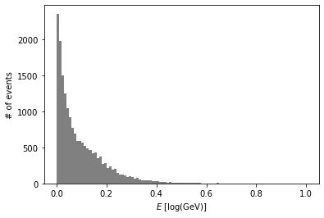
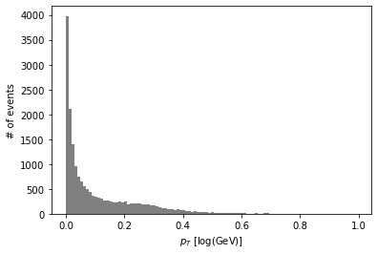
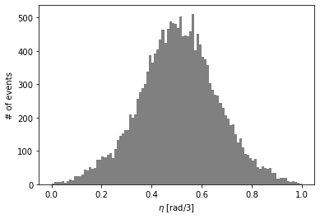
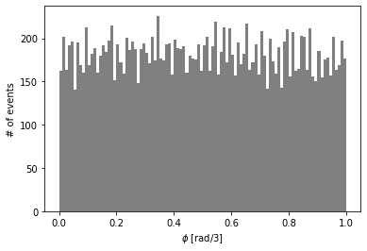
Data pre-processing
For every ATLAS triggered event, data about particles were extracted from the event data
Upon detection of the given particle (jets), the required values of variables ( E, p_{t}, η, Φ ) were extracted from the particle data
The values were normalised (0 to 1) and stored as a dataset
Total 22661 jets were detected
Following plots show the distribution of variables ( E, p_{t}, η, Φ ) respectively as histograms

Slide 4
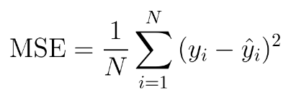
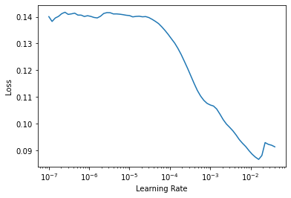
Compression Technique (Autoencoder)
We have used an autoencoder (AE) to reduce the dimensionality of four-momentum data in 4 variables to 3 variables.
The AE had three layers (with 200, 200 and 20 neurons respectively) for encoding, one layer (3 neurons) for compressed data, and three layers (20, 200 and 200 neurons) for decoding, while the input and output layers had 4 neurons each.
Mean Squared Error (MSE) has been used to measure the accuracy or loss.
The hyperparameters used for the AE are:
learning rate ~ 1.5 x 10⁻³ , which is one-tenth of the learning rate of minimum loss (as shown in figure)
weight decay ~ 1.0 x 10⁻⁶

Slide 5
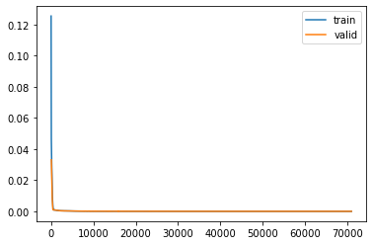
Training and Testing
The AE model requires values called weights (corresponding to each neuron pair of adjacent layers), for encoding and decoding.
To find these weights we had trained the model.
80% of the dataset was used for training and rest was used for testing.
The AE was trained for 1000 epochs in batches of 256.
For each epoch and batch, the MSE for training and validation has been shown in the figure. The horizontal overlapping lines describe the AE to be optimum.
The MSE of the AE upon validation was found to be 2.51 x 10⁻⁷ , which means the AE is fairly accurate.

Slide 6
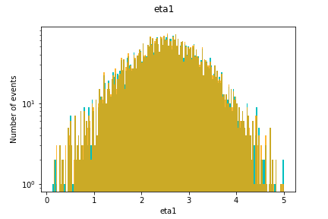
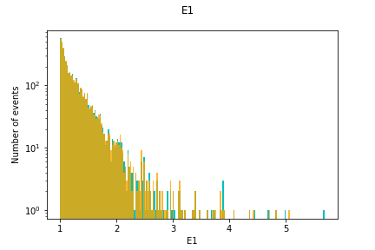
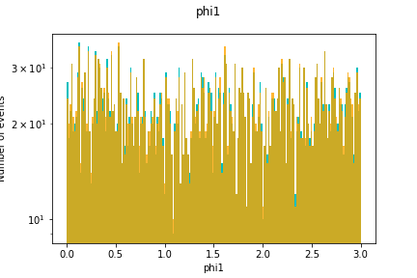
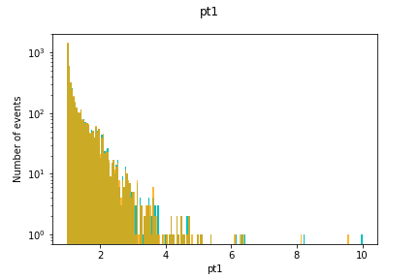
Results
The shown figures are the histograms of inputs (in blue) and outputs (in yellow) of the AE.
Since, almost all the inputs are covered by the outputs, we can infer that the technique is fairly accurate.

Slide 7
Thank you

